Slide 1

What is Scrum?
Martin schray

Slide 2
What is Scrum?
What is agile?
What is scrum?
What is it good for?
Who is involved in scrum?
What are the events (ceremony) in Scrum?
What are the artifacts in scrum?

Slide 3
What is agile?

Slide 4
What is agile?
Agile is a recognition to some that Waterfall development failed very frequently and needed a better approach
Waterfall development is a development methodology where all design work and decisions are made before development begins by capturing extensive written requirements
There are many agile frameworks like Kanban, Scrum, Extreme programming, Feature Driven development, …
Agile is about getting just enough information and building it iteratively (over, and over and over)

Slide 5
Agile in a nutshell
Get just enough info
Build it
Learn

Slide 6
What is scrum?

Slide 7
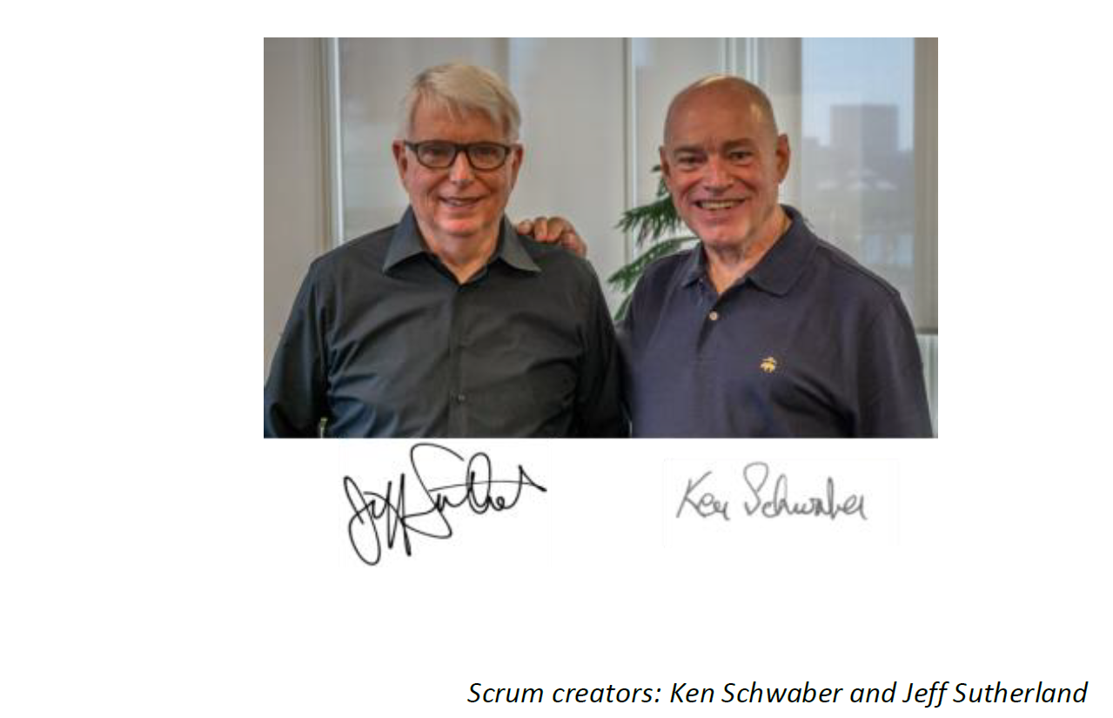
What is scrum
Where did Scrum come from?
It is one of many agile frameworks like Kanban, Scrum, Extreme programming, Feature Driven development, …

Slide 8
What is scrum?
Scrum is not a process, technique, or definitive method …
What you do include that framework is up to you
Scrum is a framework within which you can employ various processes and techniques.

Slide 9










Why scrum?

Slide 10
Why scrum?
List of rules for simple tasks
Making a hamburger
Making a burrito
…

Slide 11
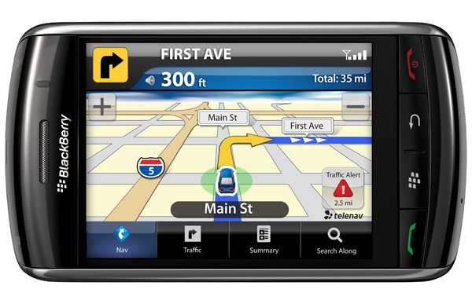
Why scrum?
This Photo by Unknown Author is licensed under CC BY-SA
Not easily reproducible
Build complex software
Complete a complex project (IPro)
Any effort with many stakeholders
Efforts with many unknows and uncertainty
Scrum excels at these tasks

Slide 12
Scrum is empirical process
Inspection
Adaption
Transparency

Slide 13
Roles in scrum

Slide 14

Roles in Scrum
Product owner
Development Team
Scrum Master

Slide 15
What does each role do?
Product owner – responsible to capture value for the business
Development Team – responsible to deliver product incrementally
Scrum Master – Guide to Scrum

Slide 16
Ceremonies (Events/meetings) in scrum

Slide 17
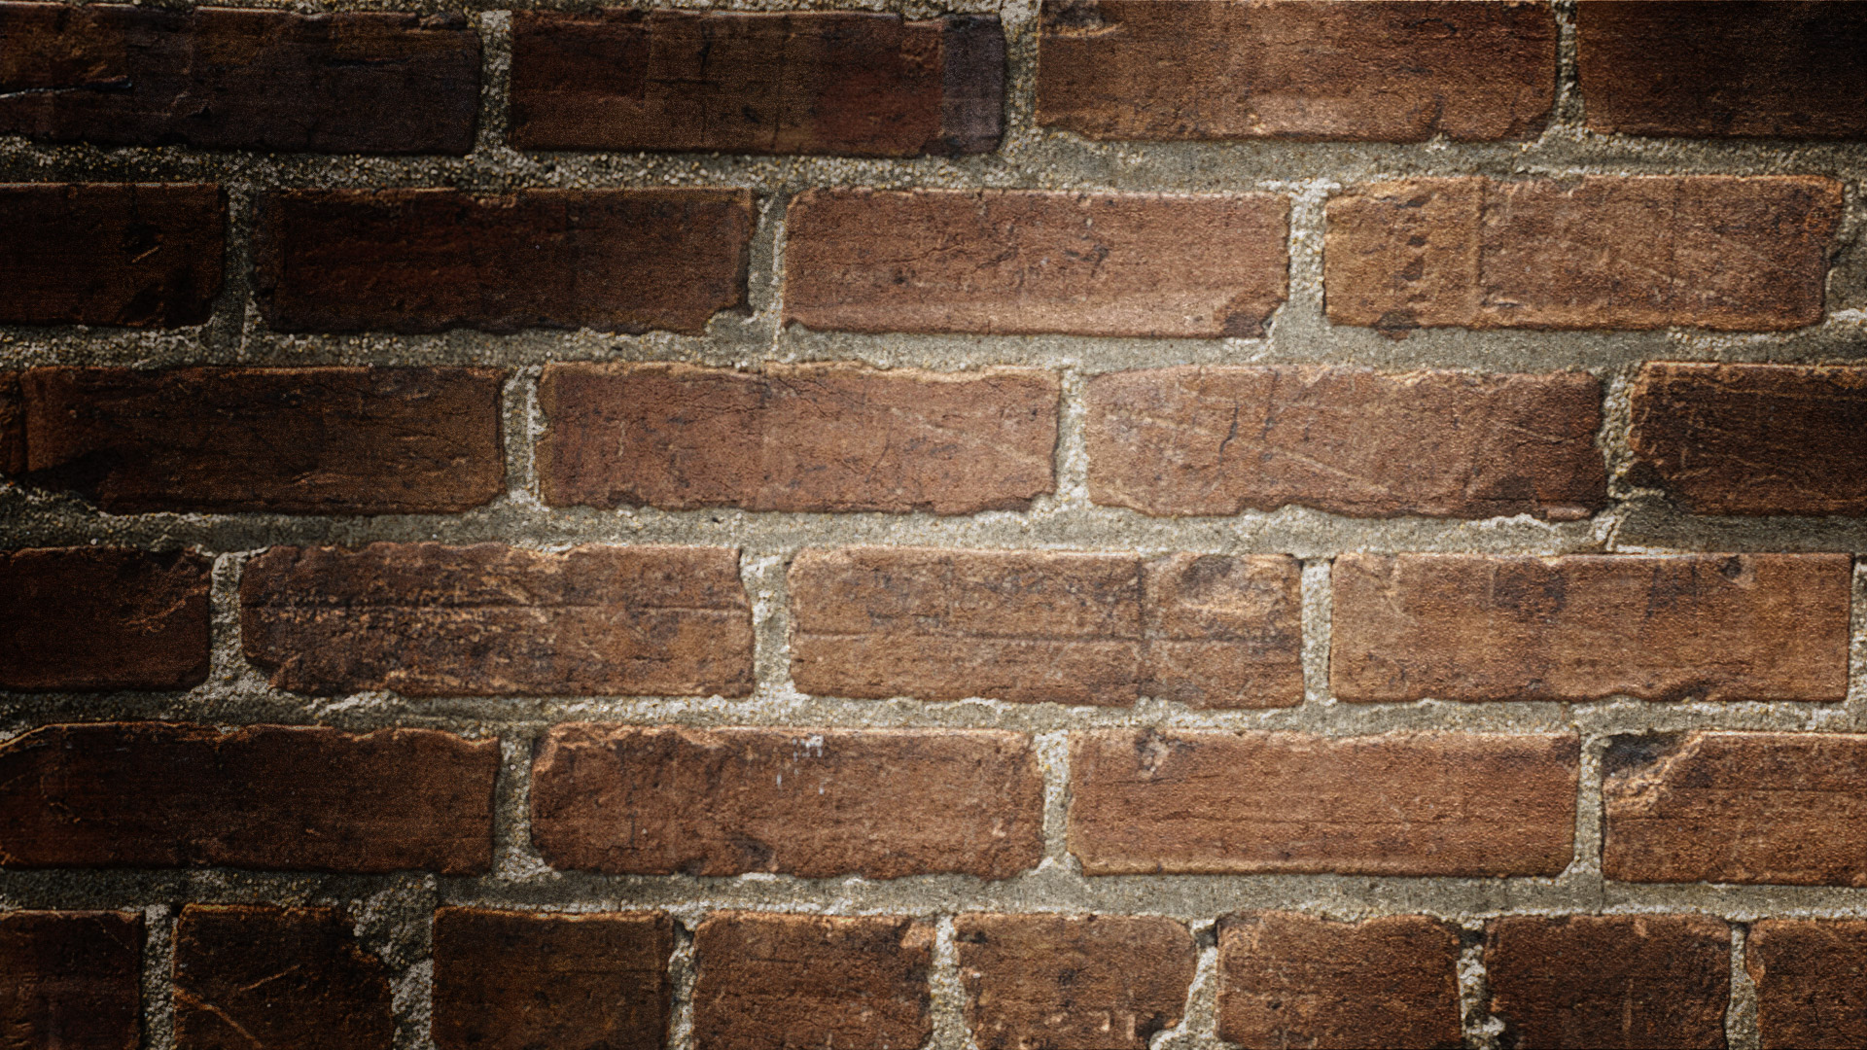

Agile Ceremonies
Scrum or daily standup
(1 o 4 weeks)
Sprint Review
Sprint Retro
Sprint planning

Slide 18
Scrum Values
Focus
Openness
Respect
Courage
Commitment

Slide 19
Artifacts in scrum

Slide 20
Artifacts
Product Backlog
Sprint Backlog
Product increment

Slide 21

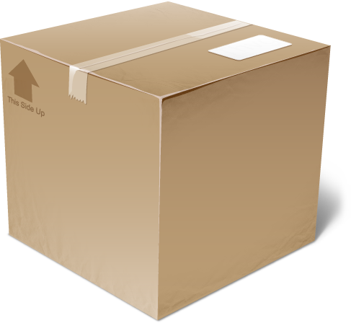
The Sprint
Scrum or daily standup
(1 to 4 weeks)
Sprint Review
Sprint Retro
Sprint
Backlog
Product
Backlog
Sprint planning
Product
increment

Slide 22
